Slide 1
Safecracking
Joe Ryan, Laney Winkler

Slide 2
Key pads use a 4x4 matrix
1 number on the keypad is controlled by shorting two wires in the matrix

Slide 4
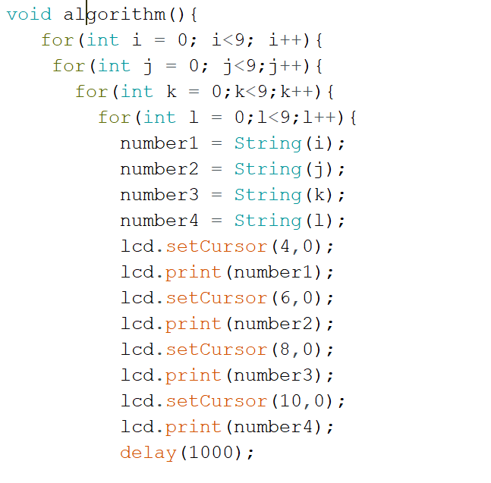
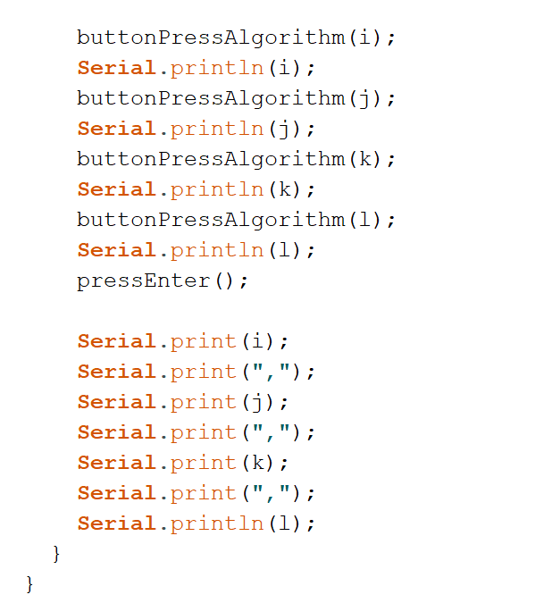
Algorithm to Cycle through Possible Combinations

Slide 5
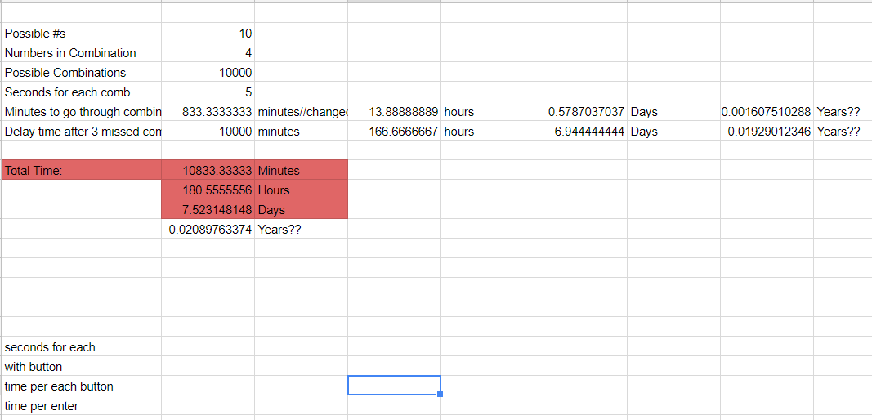
Time to Open Safe
Notes:
https://docs.google.com/spreadsheets/d/1se6MEAybvxT8crPV1tEDydAJDBXWvsk_io9PDxZ2RfI/edit?usp=sharing

Slide 6
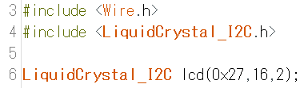
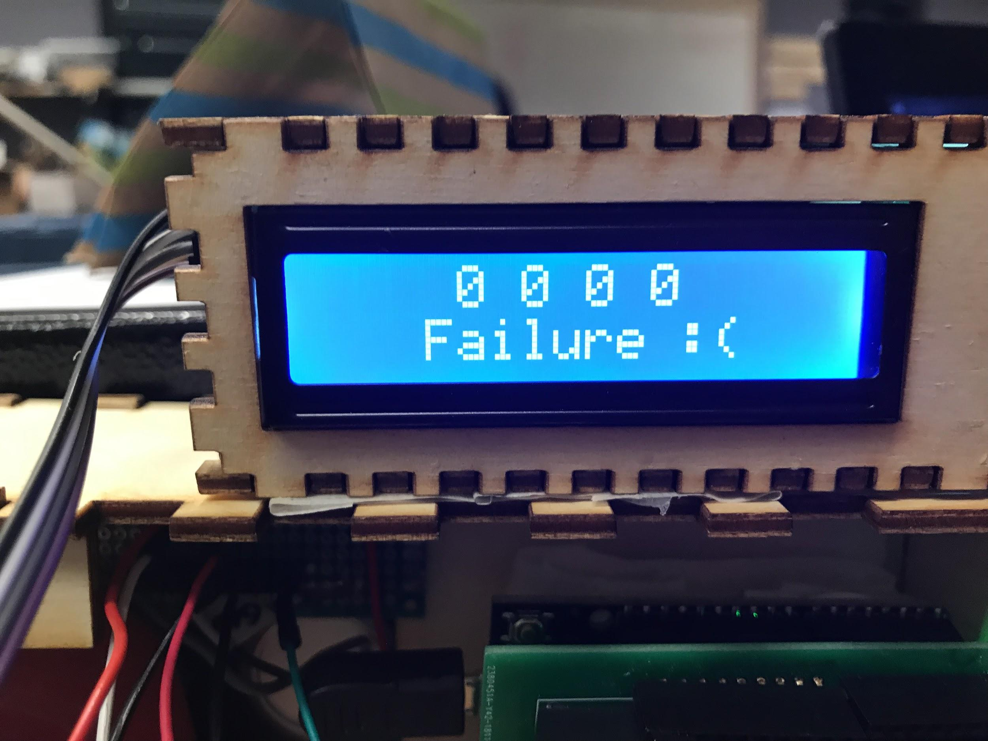
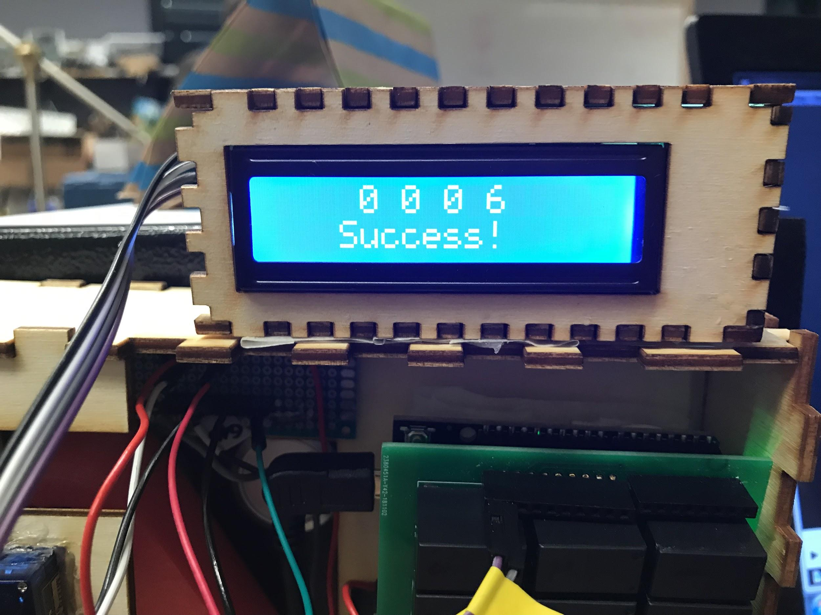
Display
I2C LCD Display

Slide 7
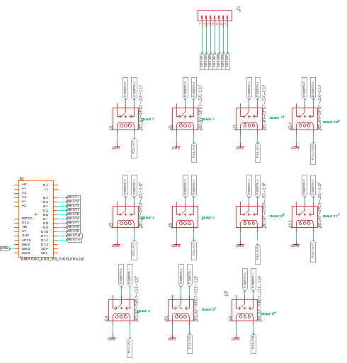
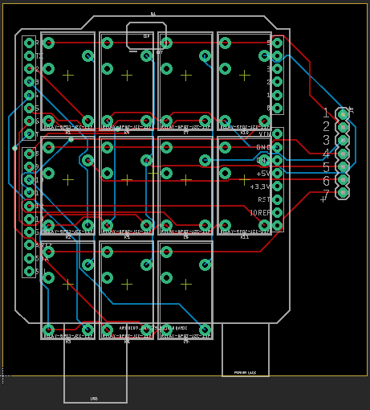
PCB

Slide 8
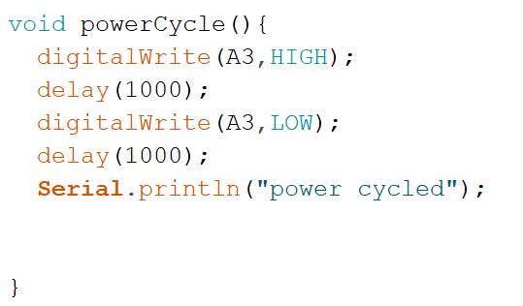
Lockout Timer
Accessed the safe’s power supply
Used relay to short wires
Decreased opening time from 7.5 Days to 13.8 Hours (max try time)

Slide 9
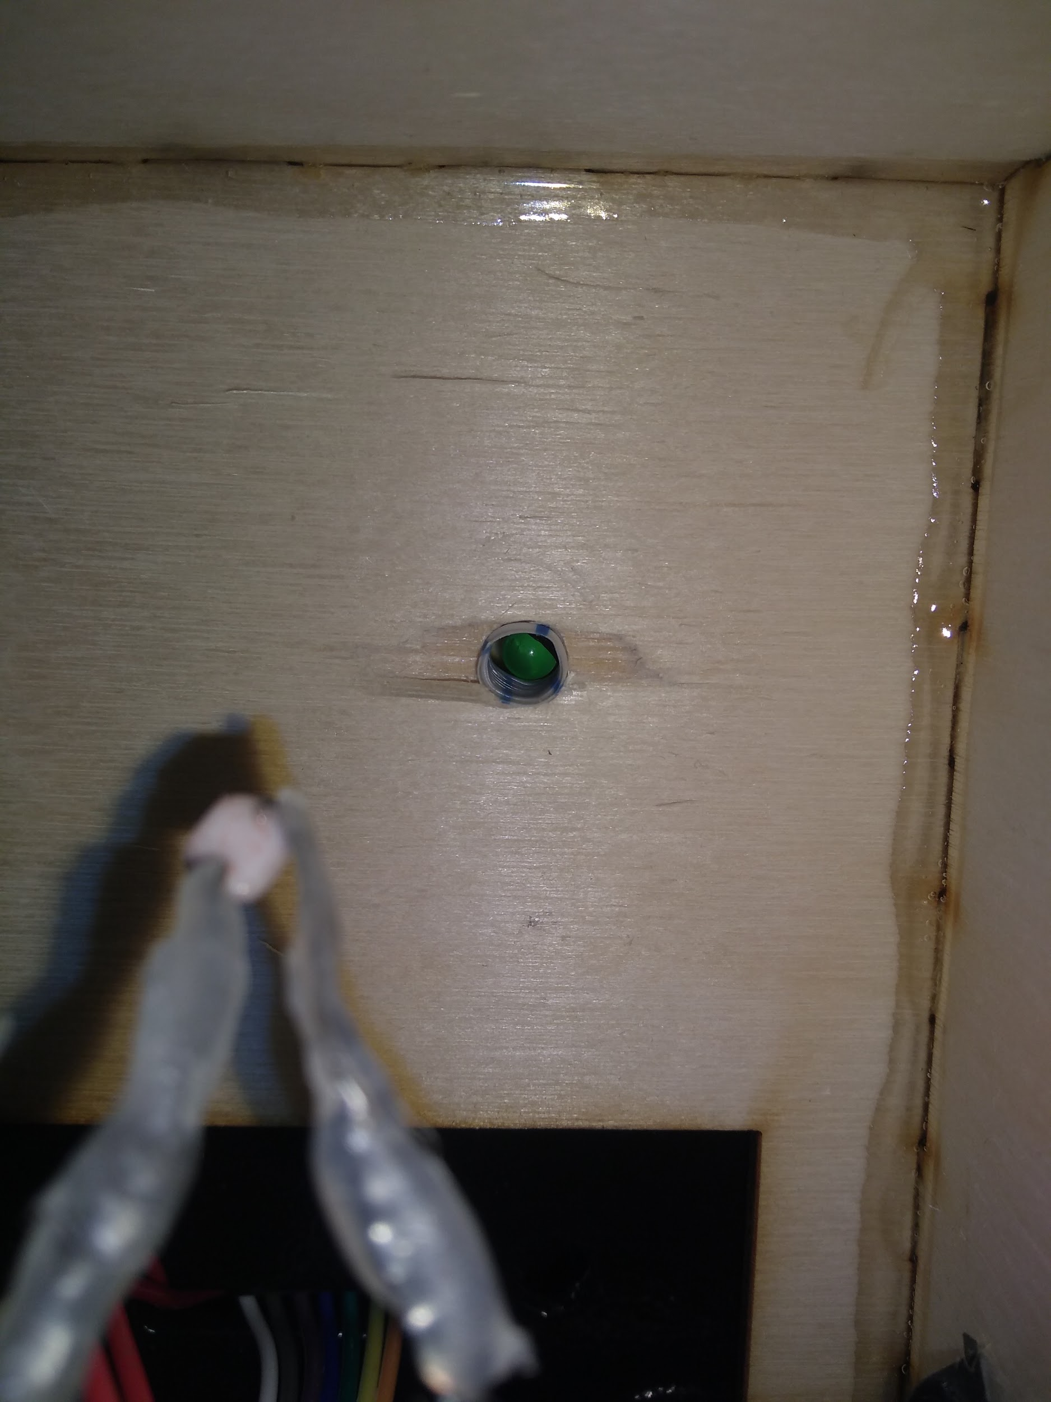
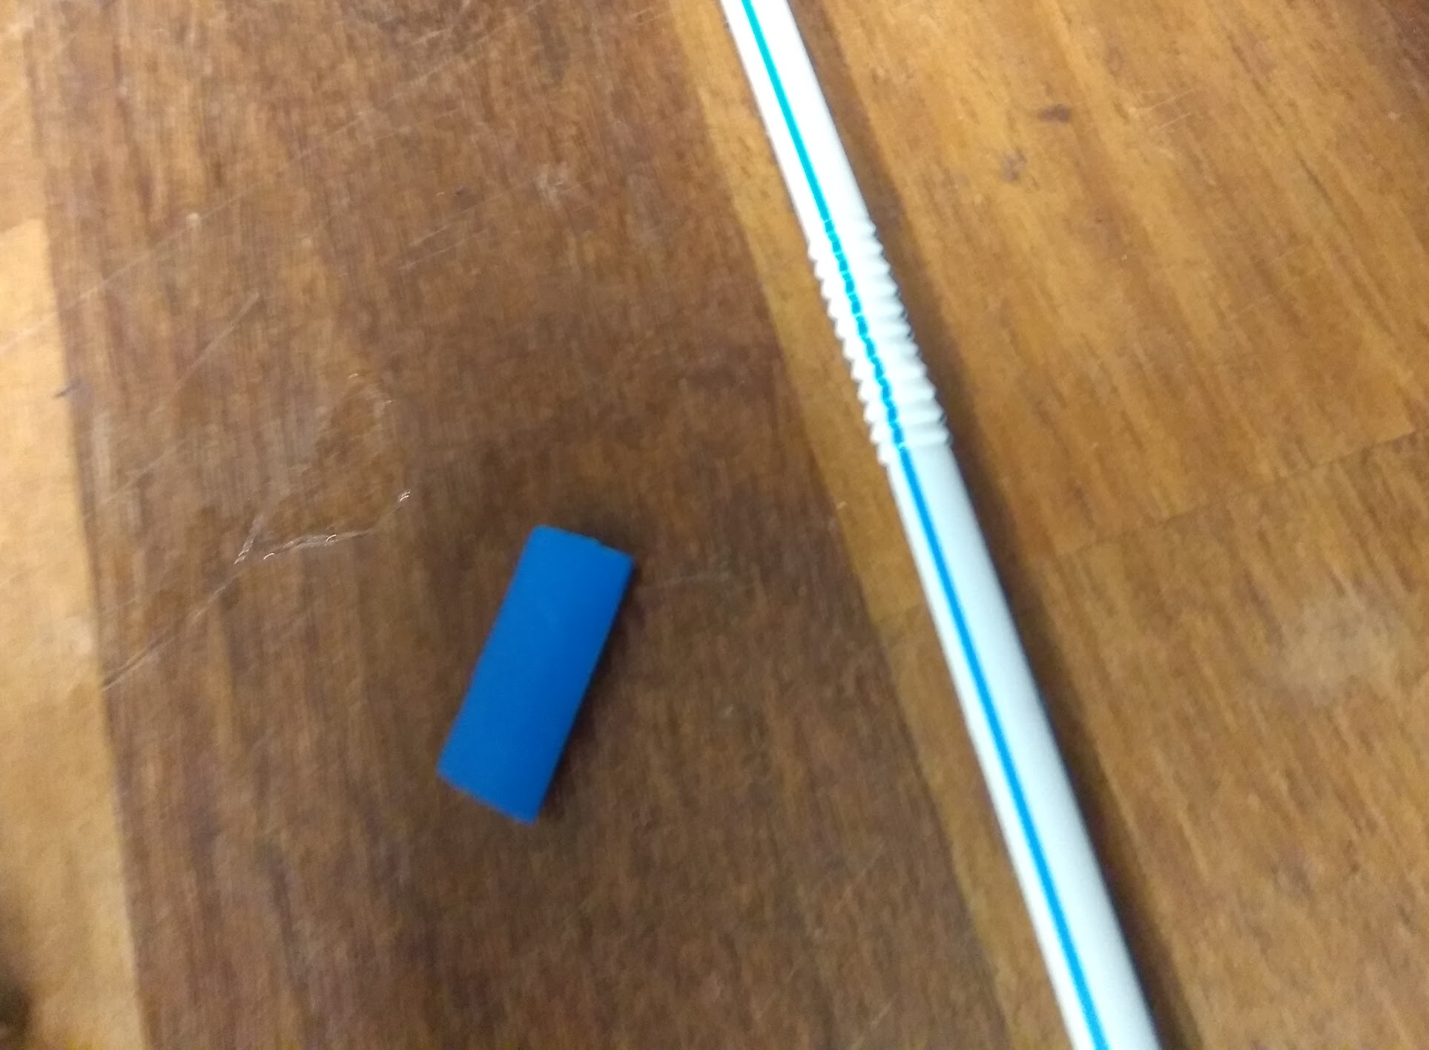
Photocell

Slide 10
The “0000” Paradox
Ruled out Theories
Does not happen on power cycle
Does not happen when all wires are shorted together
Does not happen when too many combinations are added
Current Theories
A “button” is pushed for a certain amount of time
A certain pattern of wires are shorted
Notes:
-How we actually opened the safe
-Due to some unknown reason, the combination resets to “0000”
-The first combination tried in the the algorithm

Slide 11
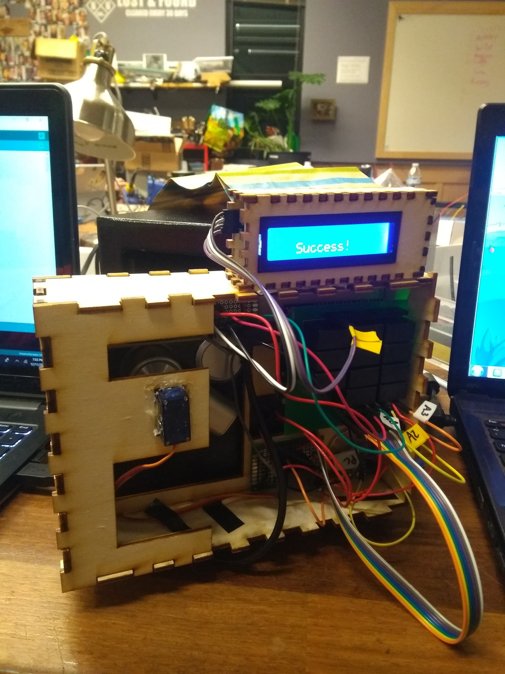
Safe = Cracked

Slide 12


